Slide 1






Pengolahan
Citra
Crazy Rich
H A N D I N A T A - 4 1 2 0 1 9 0 4 4
A L B E R T S U T A N D I - 4 1 2 0 1 9 0 4 3
R O | B | E | R | T | C A R | L | O |  | S - |  | 4 | 1 2 | 0 | 1 | 9 | 0 | 5 | 4
M I | C | H | A | E | L V A | L | L | I | A N | T |  | - | 4 | 1 | 2 | 0 | 1 | 9 | 0 | 1 | 9

Slide 2





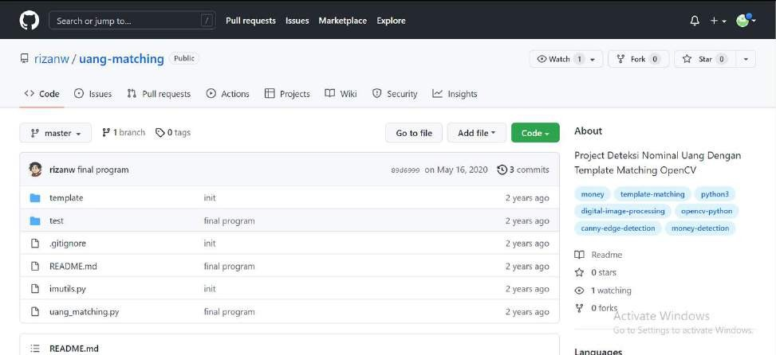

Sumber:
https://github.com/rizanw/uang-matching

Slide 3




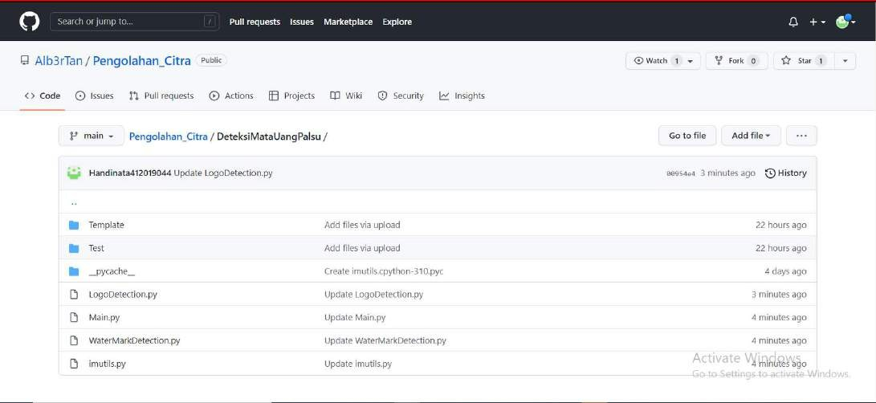
https://github.com/Alb3rTan/Pengolahan_ Citra/tree/main/DeteksiMataUangPalsu

Slide 4


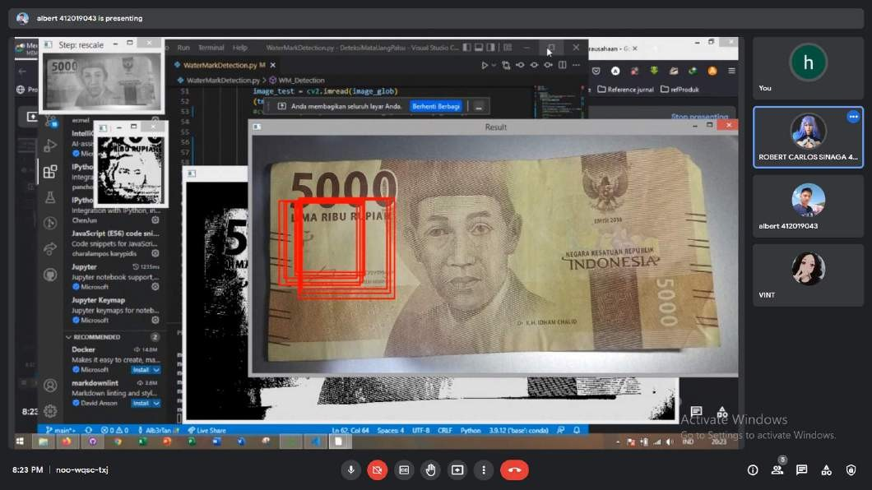

Meet
Business StartUp

Slide 5

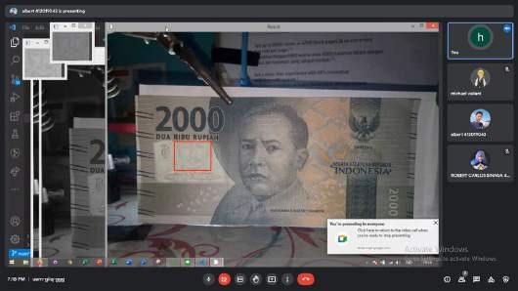
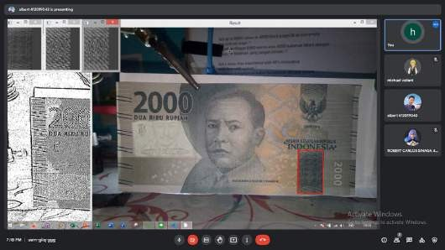
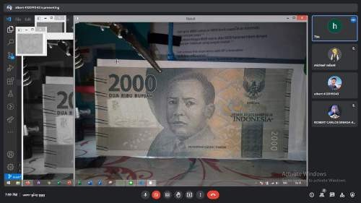
HASIL
Asli
Palsu

Slide 6
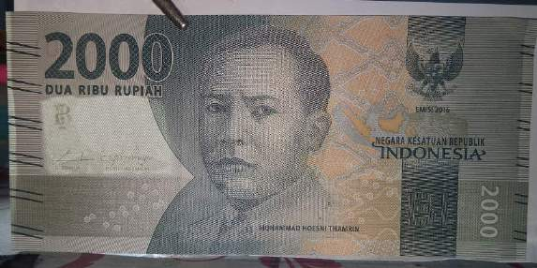
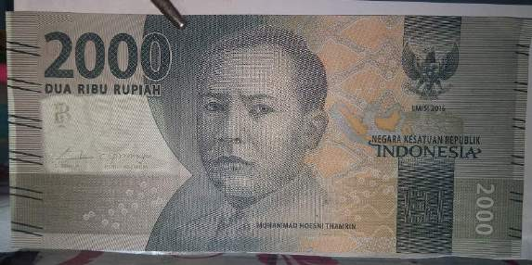


File Image
Palsu
Asli
WaterMark
Logo BI

Slide 7
a
n
k
Y
h
o
T
u

